Slide 1

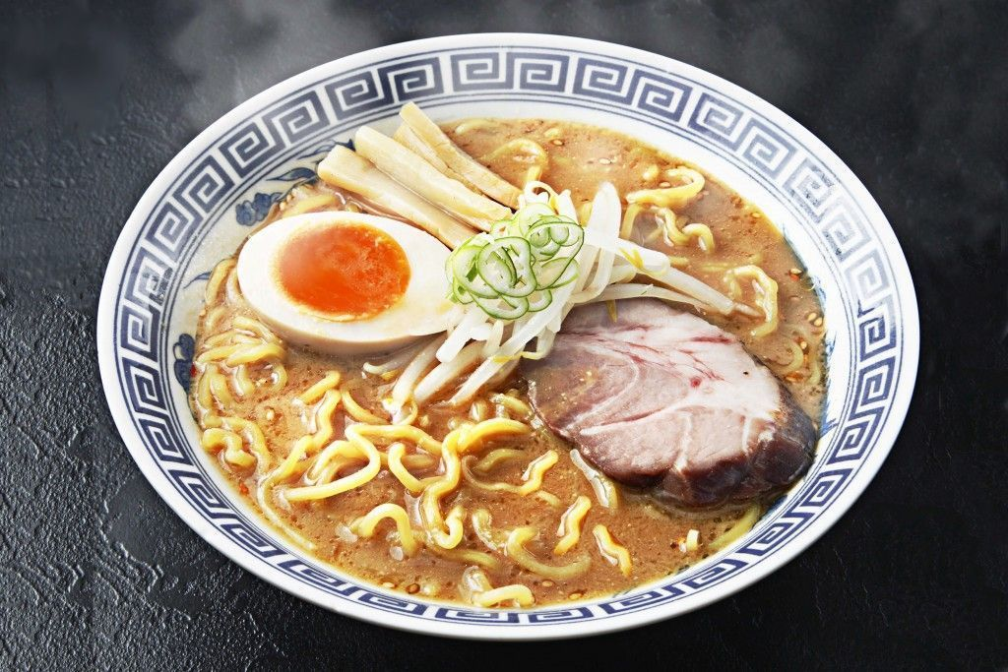
New Ramen Restaurant in New York City Where is the best place to open the restaurant?
This Photo by Unknown Author is licensed under CC BY-SA-NC

Slide 2

Introduction
New York City has is the place where is high competition for restaurant businesses. Every year, new restaurants open, and many restaurants cannot survive the competition and close down for good. One factor of the successful restaurant business is the location. Even though the restaurant has an excellent chef and serves excellent food, if the accessibility was good enough, it cannot build enough positive reviews to attract more people to come.
This Photo by Unknown Author is licensed under CC BY-SA

Slide 3
Objectives
Find the best location to open a new Ramen restaurant in New York City
Identify the area where is the small number of crimes occurred in the past.
Find the less competitive area for the ramen restaurant
Number of the restaurants in each borough
Number of the ramen restaurants in each borough

Slide 4
Data
FourSquare API data
to identify the low number of restaurant/ramen shops in the neighborhood.
NYPD Complaint Data Historical
This dataset includes all valid felony, misdemeanor, and violation crimes reported to the New York City Police Department (NYPD) from 2006 to the end of last year (2017). For additional details, please see the attached data dictionary in the ‘About’ section. (NYC Open Data, 2018)

Slide 5
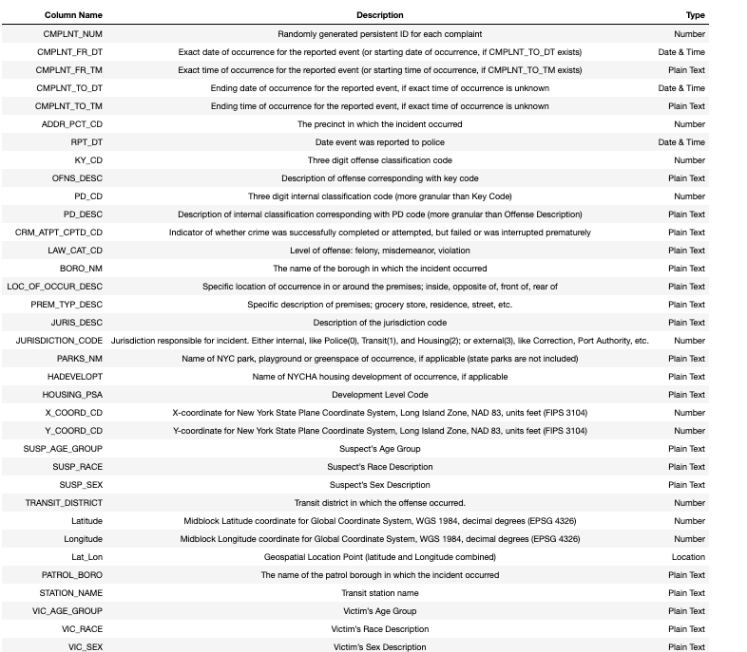
Snapshot of the crime dataset (31 Columns/40,000 observations)

Slide 6
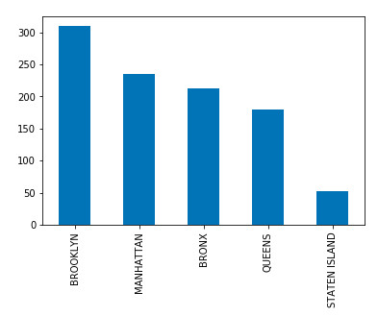
The number of crimes in each borough
Brooklyn has the highest number of crimes among 5 borough.
Staten Island has the lowest number of crimes.

Slide 7
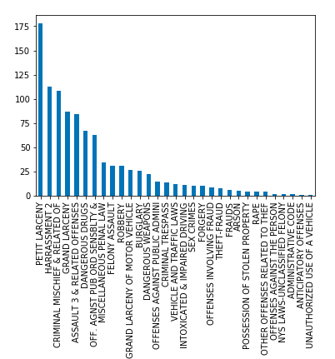
Offence by borough
Petit Larceny has the highest number of the offence categories.

Slide 8
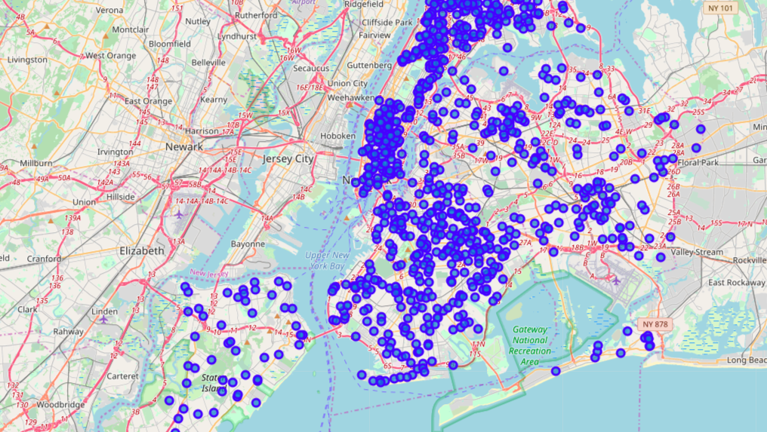
Crime complaints on NYC map
Crime complaints are populated in Manhattan, Bronx, and Brooklyn area on a map

Slide 9
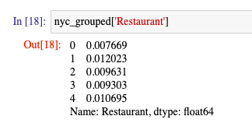
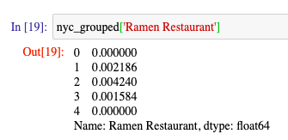
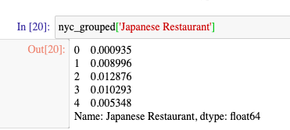
The frequency of restaurants/ramen restaurants in each borough
0: The Bronx
1: Brooklyn
2: Manhattan
3: Queens
4: Staten Island
Staten Island has the least frequency for the all the categories. (Restaurant, Ramen Restaurant, and Japanese Restaurant)

Slide 10
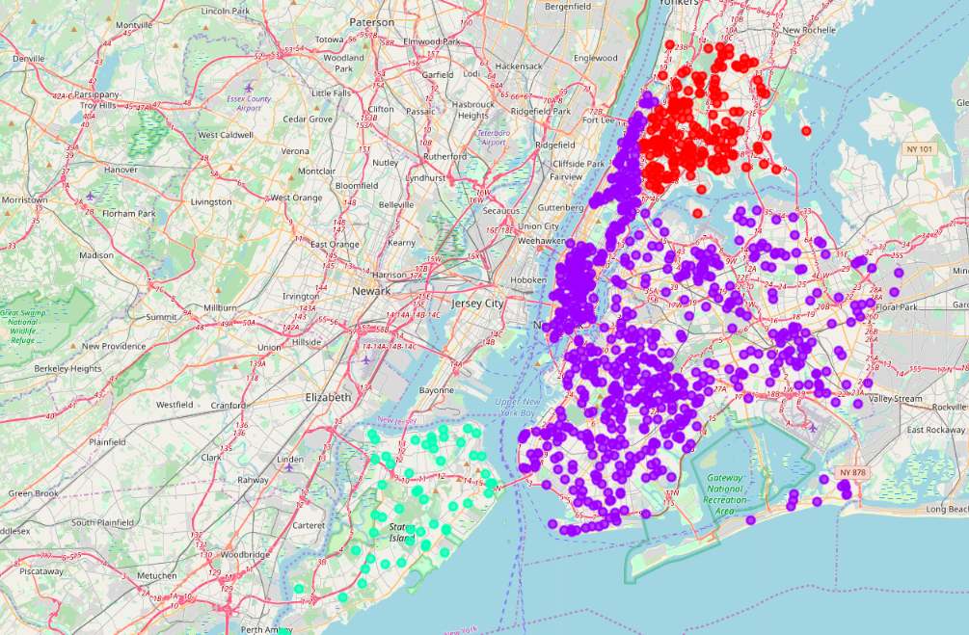
Cluster Analysis (Number of clusters =3)
Clusters are assigned, and shown on a map by color.

Slide 11
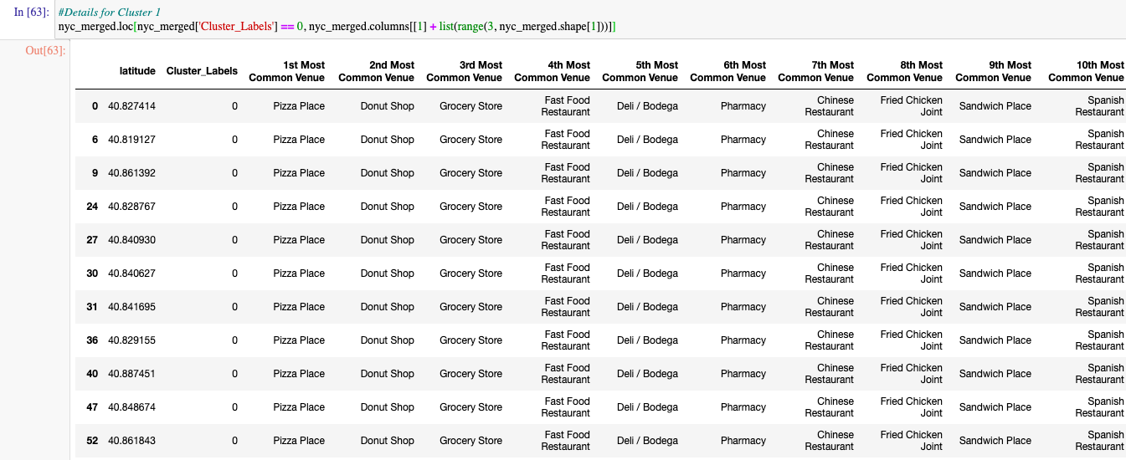
Cluster 1
The Bronx area's most populated venue is the pizza place, doughnut shop, and grocery store..etc

Slide 12
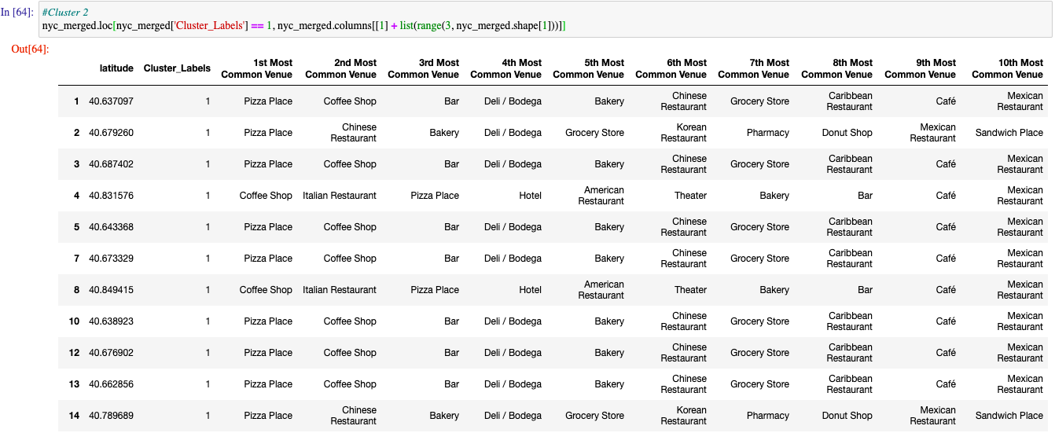
Cluster 2
Manhattan, Queens and Brooklyn areas have a lot of restaurants (Pizza place, coffee shop, bar...etc)

Slide 13
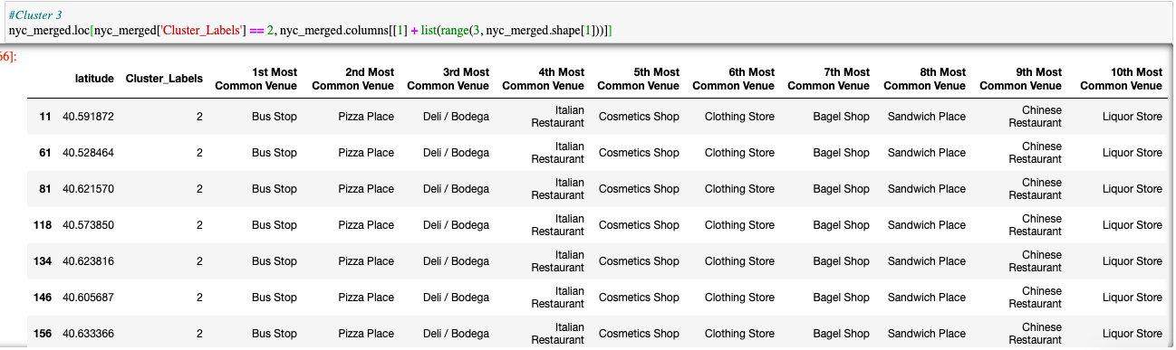
Cluster 3
Non restaurants venues are more populated in Staten Island,
although pizza place and Italian restaurant are popular in the area.

Slide 14
Result
Based on NYPD complaint data, the bar chart and map show Staten Island is the safest borough in New York City
the foursquare data shows that the highest number of the restaurant exists in Manhattan, and Staten Island has the least number of restaurants.
There are more Japanese restaurants in Manhattan and Brooklyn than three other boroughs, The Bronx and Queens.
Staten Island is less likely to be competitive and the safest borough among five boroughs for a new ramen shop.
Cluster analysis revealed that Manhattan, Queens and Brooklyn areas have a lot of restaurants (Pizza place, coffee shop, bar,,,etc.)
The Bronx area's most populated venue is the pizza place, doughnut shop, and grocery store,,,etc.
Non restaurants venues are more populated in Staten Island, although pizza place and Italian restaurant are popular in the area. For a ramen shop, there are less competitive and more opportunity for the restaurant location.

Slide 15
Conclusion
Staten Island is the best place for a new ramen shop to open in New York City.
Staten Island shows the least number of crimes occurred, and the least number of restaurants and ramen shop among the borough.
For the future analysis, the study should include other factors which can lead the successful of the establishing a business such as population in the area.

Slide 16
References
NYPD Complaint Data Historical, retrieved from: https://data.cityofnewyork.us/Public-Safety/NYPD-Complaint-Data-Historic/qgea-i56i

